Slide 1
New Frontiers of Knowledge Graph Reasoning: Recent Advances and Future Trends
Part IV: Neural Reasoning Beyond Entities and Relations (1)
Yangqiu Song
Department of CSE, HKUST

Slide 2

Roadmap
Part I: Knowledge Graph Reasoning: Basic Concepts and Techniques
Part II: Recent Advance #1: Neural Reasoning for Natural Language Queries
Part III: Recent Advance #2: Neural Reasoning for Logical Queries
Part IV: Recent Advance #3: Neural Reasoning Beyond Entities and Relations
Part V: Recent Advance #4: LLM+KGR
Part VI: Open Challenges and Future Directions

Slide 3
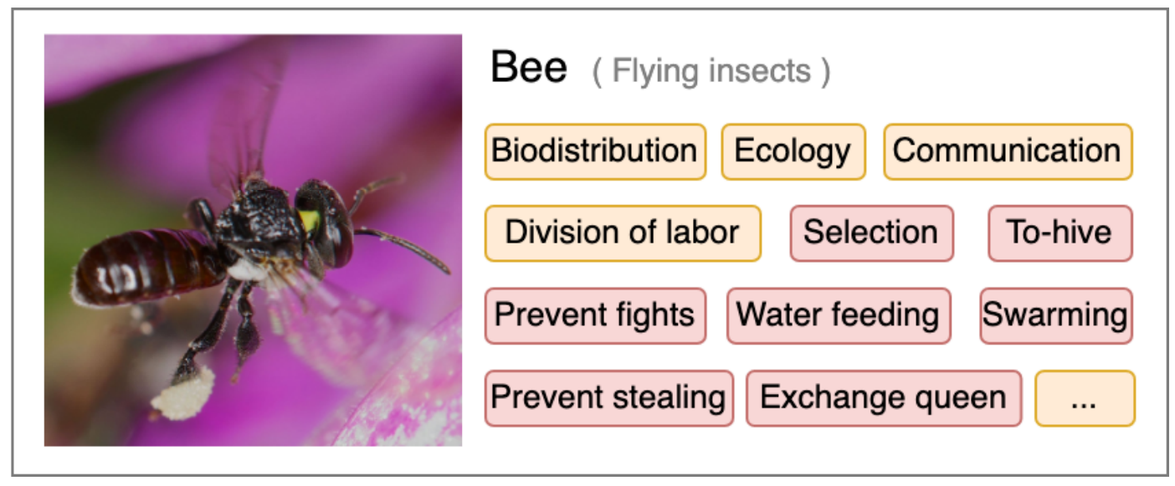
Scope of Knowledge
Awareness of facts
“Knowing that”: the truth of propositions
E.g., the population of Singapore is 5.92 million (2023)
A possession of practical skills
“Knowing how”: understanding how to perform certain actions; procedural knowledge
E.g., How to hive bees?
An experiential acquaintance: familiarity with individuals and situations
“Knowing by acquaintance”: directly perceiving an object, being familiar with it, or otherwise coming into contact with it.
E.g., by eating Durian, one becomes acquainted with the taste of it
The aspects in orange boxes are aspects that convey the knowledge of “know-what” or “know-why”, while those in red boxes convey the knowledge of “know-how”.
Source: Kuaipedia
https://en.wikipedia.org/wiki/Definitions_of_knowledge#Non-propositional_knowledge
Kuaipedia: a Large-scale Multi-modal Short-video Encyclopedia Haojie Pan, Zepeng Zhai, Yuzhou Zhang, Ruiji Fu, Ming Liu, Yangqiu Song, Zhongyuan Wang, Bing Qin. Arxiv 2022.

Slide 4
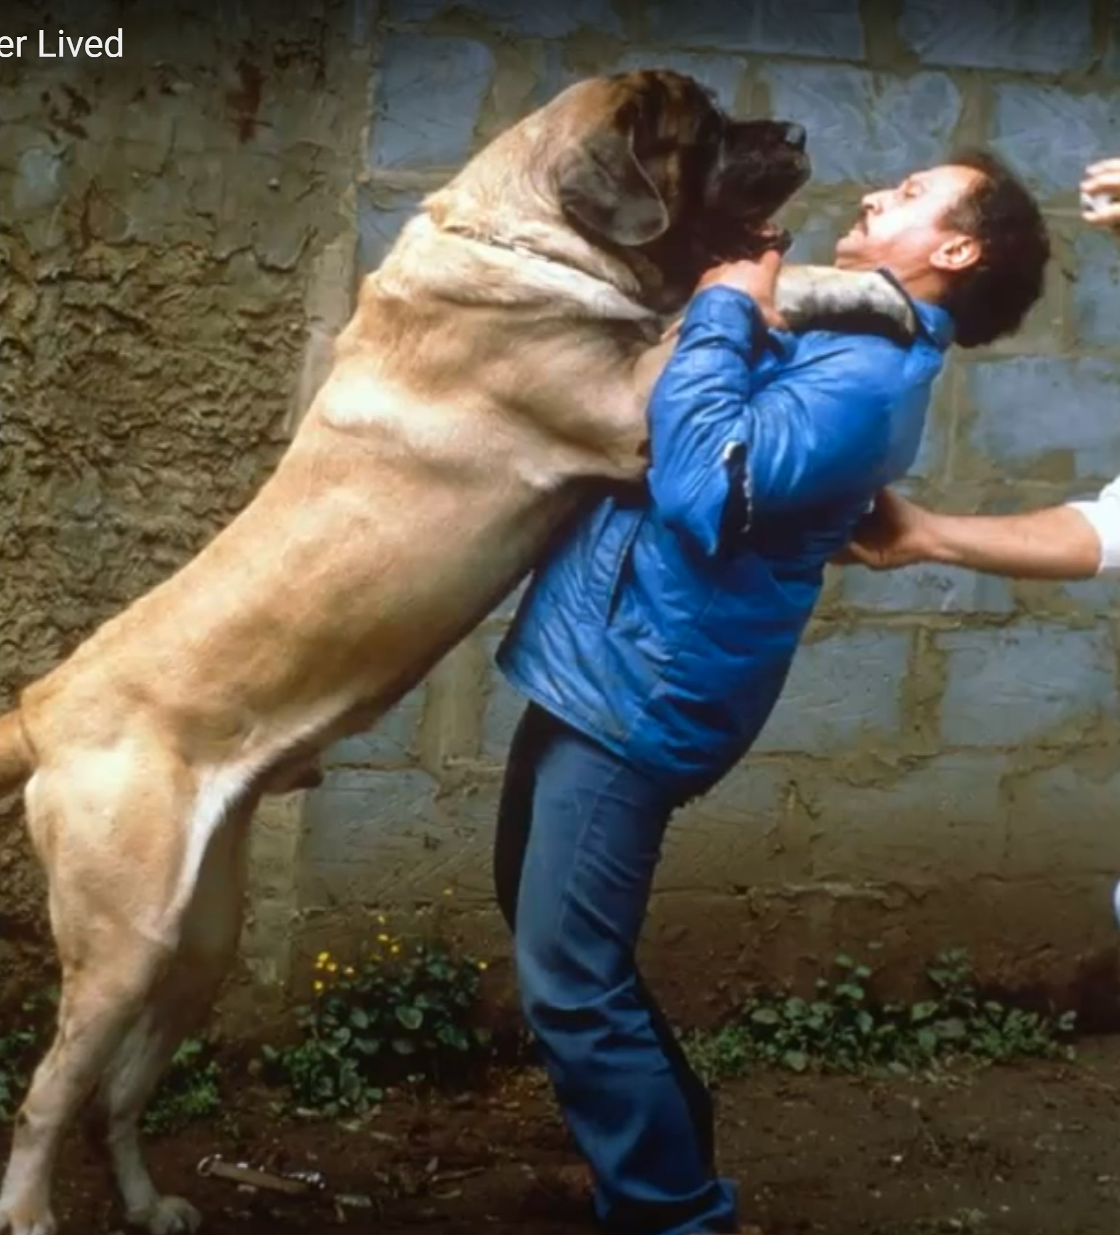
Commonsense Knowledge in AI
"Commonsense knowledge includes the basic facts about events (including actions) and their effects, … how it is obtained, facts about beliefs and desires. It also includes the basic facts about objects and properties. “ – John McCarthy
“While to the average person the term ‘commonsense’ is regarded as synonymous with ‘good judgement’, the AI community it is used in a technical sense to refer to the millions of basic facts and understandings possessed by most people.” --ConceptNet
“Such knowledge is typically omitted from social communications”, e.g.,
If you forget someone’s birthday, they may be unhappy with you.
Meanwhile, it is not invariably true
“a person is larger than a dog”
Source: Zorba - The World's Largest Dog Ever Lived
McCarthy, John. "Artificial intelligence, logic and formalizing common sense." Philosophical logic and artificial intelligence. Springer, Dordrecht, 1989. 161-190.
Hugo Liu and Push Singh, ConceptNet - a practical commonsense reasoning tool-kit, BTTJ, 2004

Slide 5
The Three-dimensional Development of Knowledge Graphs in Computer Science
The deveopment of the Web
In the past years the development of knowledge graph has been largely changed (or revolutionized) by deep learning and NLP
Web 3.0
Xin Luna Dong. Generations of Knowledge Graphs: The crazy ideas and the business impact. VLDB, 2023. Invited paper for VLDB Women in Database Research Award. [Paper][Talk]
Generations of KGs
G#3: Dual Neural KGs
Web 2.0
G#2: Text-Rich KGs
G#1: Entity-Based KGs
Web 1.0
Entities/Concepts/Properties
Events/Processes
Intents/Beliefs/Desires
Semantic Units
Generations of KGs: Xin Luna Dong. Generations of Knowledge Graphs: The crazy ideas and the business impact. VLDB, 2023. Invited paper for VLDB Women in Database Research Award. [Paper][Talk]

Slide 6
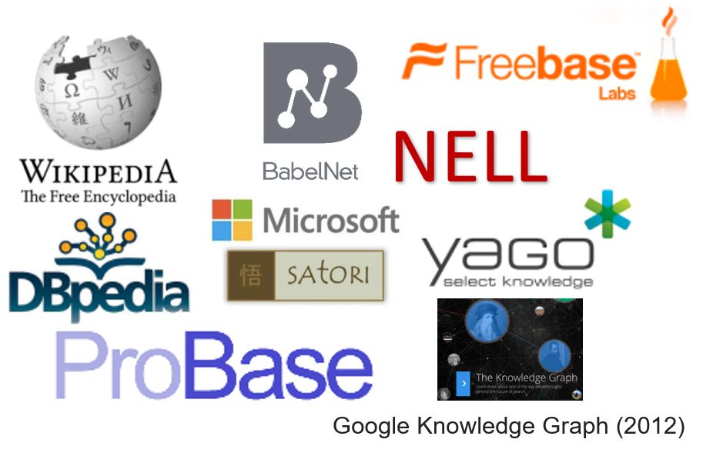
The Three-dimensional Development of Knowledge Graphs in Computer Science
The deveopment of the Web
Many large-scale knowledge graphs about entities and their attributes (property-of) and relations (thousands of different predicates) have been developed
Millions of entities and concepts
Billions of relationships
They belong to
Generation #1
Web 1.0
Entity based knowledge
Web 3.0
Generations of KGs
G#3: Dual Neural KGs
Web 2.0
G#2: Text-Rich KGs
G#1: Entity-Based KGs
Web 1.0
Entities/Concepts/Properties
Events/Processes
Intents/Beliefs/Desires
Semantic Units
Generations of KGs: Xin Luna Dong. Generations of Knowledge Graphs: The crazy ideas and the business impact. VLDB, 2023. Invited paper for VLDB Women in Database Research Award. [Paper][Talk]

Slide 7
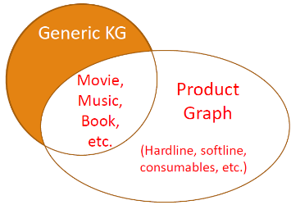

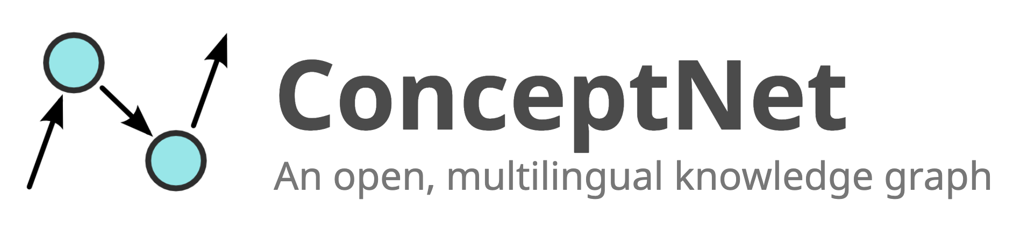

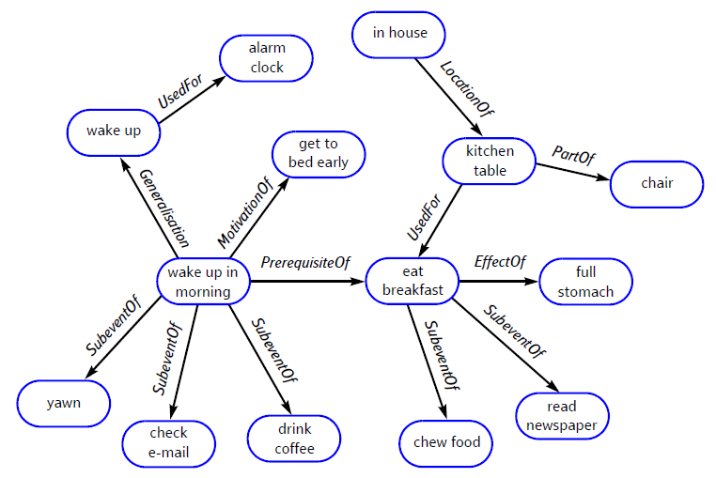
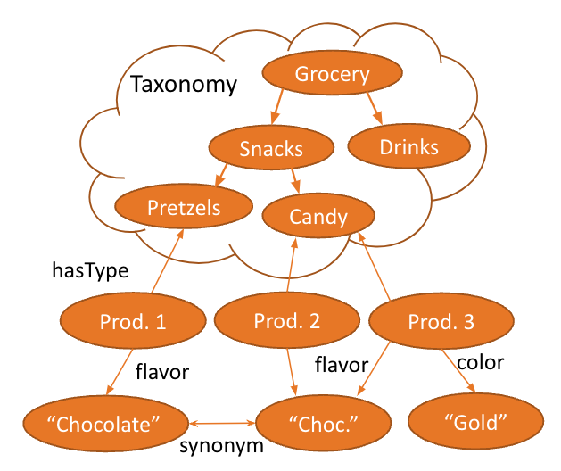
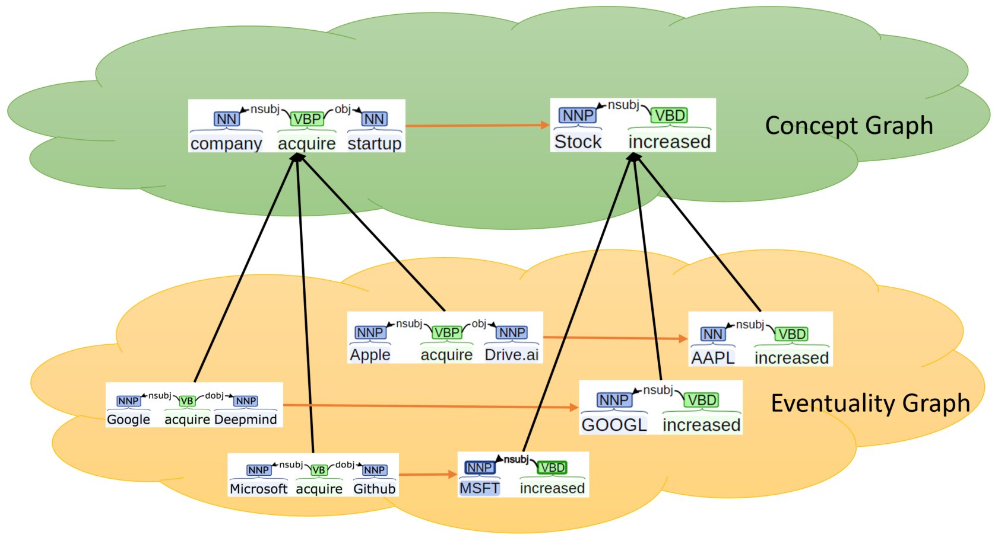
The Three-dimensional Development of Knowledge Graphs in Computer Science
The deveopment of the Web
Web 3.0
Generations of KGs
G#3: Dual Neural KGs
Web 2.0
G#2: Text-Rich KGs
Product Graph
Generation #2
Web 1.0
Entity (product) based knowledge
ASER/Knowlywood
Generation #2
Web 1.0
Event based knowledge
ConceptNet
Generation #2
Web 1.0
Entity and event based knowledge
G#1: Entity-Based KGs
Web 1.0
Entities/Concepts/Properties
Events/Processes
Intents/Beliefs/Desires
Semantic Units
Nasser Zalmout, Chenwei Zhang, Xian Li, Yan Liang, Xin Luna Dong. All you need to know to build a product knowledge graph. Tutorial in KDD'2021.
Hongming Zhang, Xin Liu, Haojie Pan, Haowen Ke, Jiefu Ou, Tianqing Fang, Yangqiu Song: ASER: Towards large-scale commonsense knowledge acquisition via higher-order selectional preference over eventualities. Artif. Intell. 309: 103740 (2022)
Niket Tandon, Gerard de Melo, Abir De, Gerhard Weikum: Knowlywood: Mining Activity Knowledge From Hollywood Narratives. CIKM 2015: 223-232
Liu, Hugo, and Push Singh. "ConceptNet—a practical commonsense reasoning tool-kit." BT technology journal 22.4 (2004): 211-226.

Slide 8
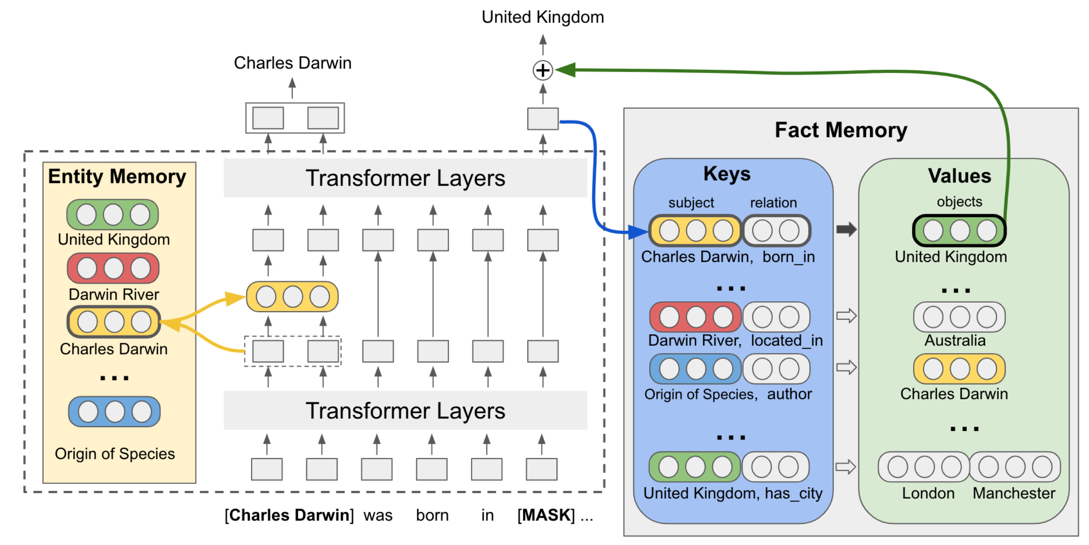
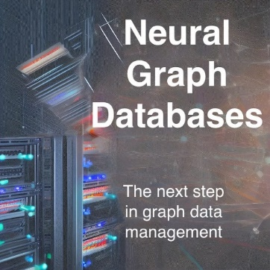
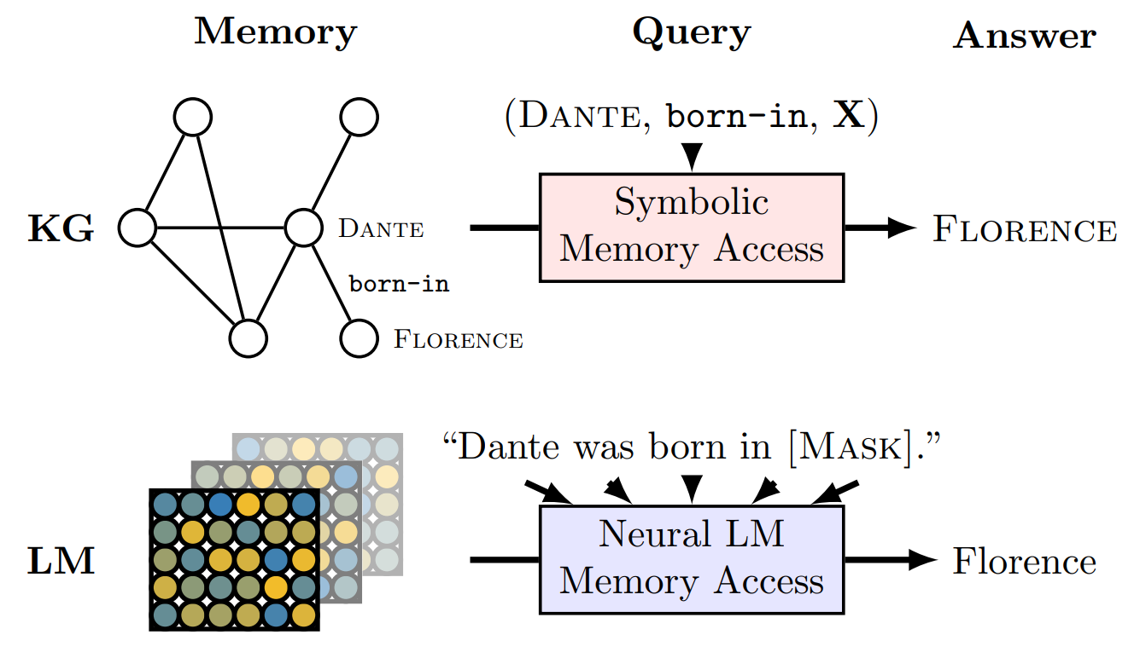
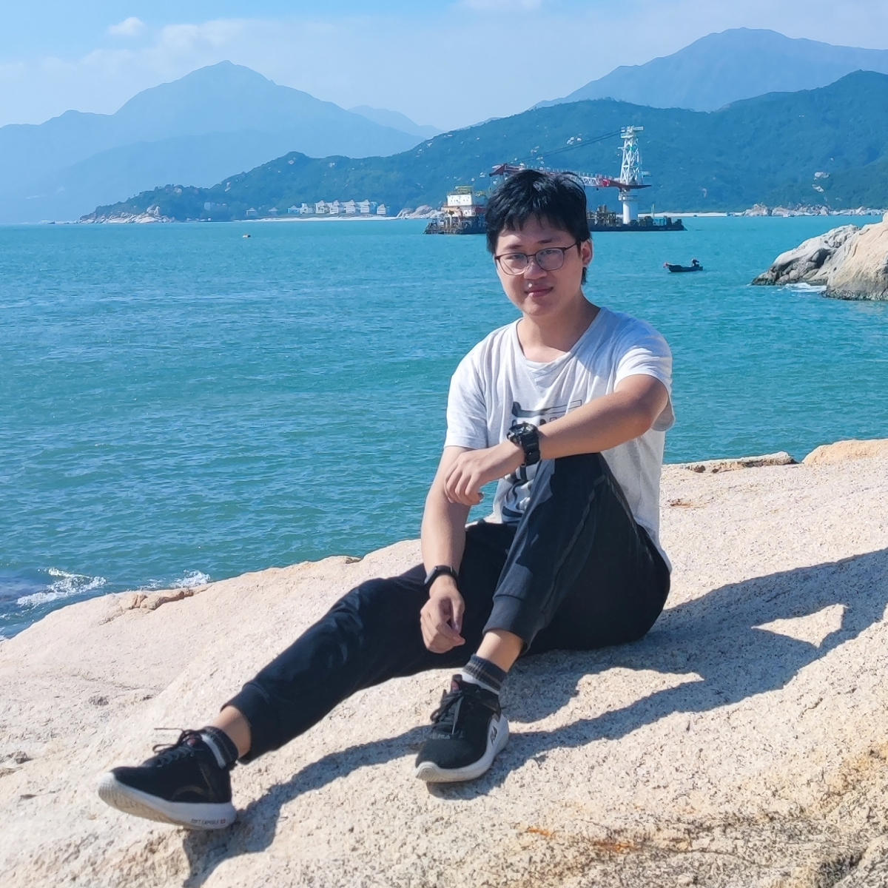

The Three-dimensional Development of Knowledge Graphs in Computer Science
The deveopment of the Web
“Language models as knowledge bases”
Neural KGs/Memory Networks/NGDBs
Web 3.0
Generations of KGs
G#3: Dual Neural KGs
Web 2.0
G#2: Text-Rich KGs
Figure of NGDBs
Zihao Wang’s part
Generation #3
Web 1.0
Entity (product) based knowledge
Jiaxin Bai’s part
Generation #3
Web 1.0
Event and Intention based knowledge
G#1: Entity-Based KGs
Web 1.0
Entities/Concepts/Properties
Events/Processes
Intents/Beliefs/Desires
Semantic Units
Figure of NGDBs taken from: https://towardsdatascience.com/neural-graph-databases-cc35c9e1d04f
Fabio Petroni, Tim Rocktäschel, Sebastian Riedel, Patrick S. H. Lewis, Anton Bakhtin, Yuxiang Wu, Alexander H. Miller: Language Models as Knowledge Bases? EMNLP/IJCNLP (1) 2019: 2463-2473
Pat Verga, Haitian Sun, Livio Baldini Soares, William W. Cohen: Adaptable and Interpretable Neural Memory Over Symbolic Knowledge. NAACL-HLT 2021: 3678-3691
Maciej Besta, Patrick Iff, Florian Scheidl, Kazuki Osawa, Nikoli Dryden, Michal Podstawski, Tiancheng Chen, Torsten Hoefler: Neural Graph Databases. LoG 2022: 31
Hongyu Ren, Mikhail Galkin, Michael Cochez, Zhaocheng Zhu, Jure Leskovec: Neural Graph Reasoning: Complex Logical Query Answering Meets Graph Databases. CoRR abs/2303.14617 (2023)

Slide 9



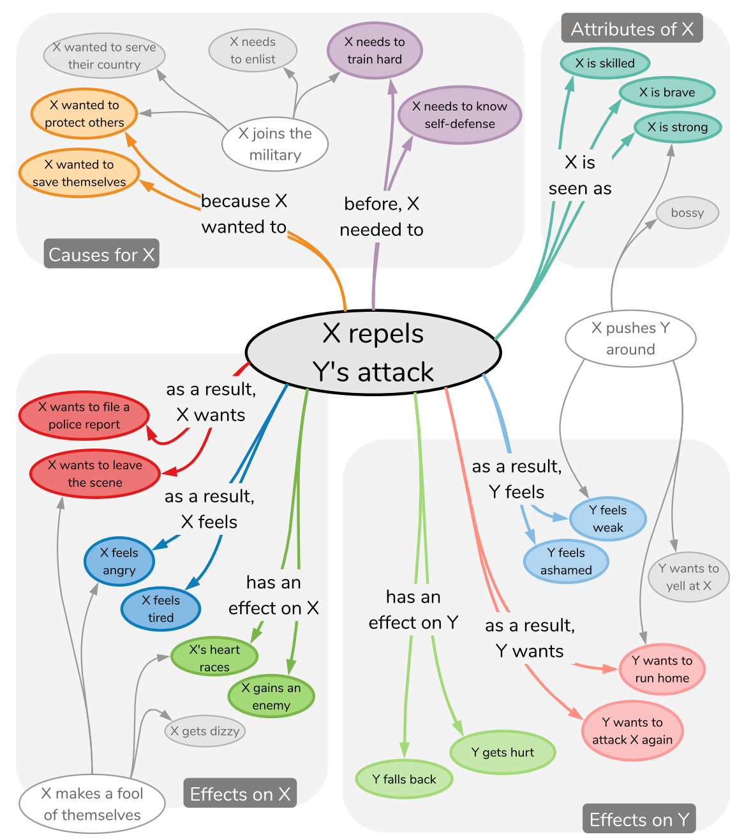
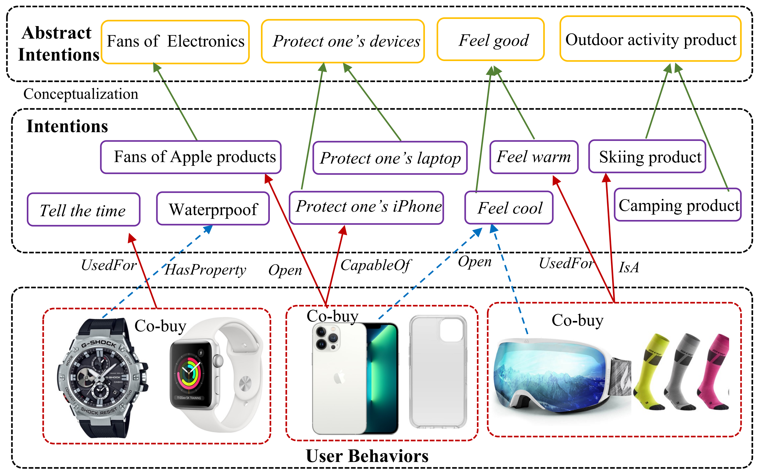
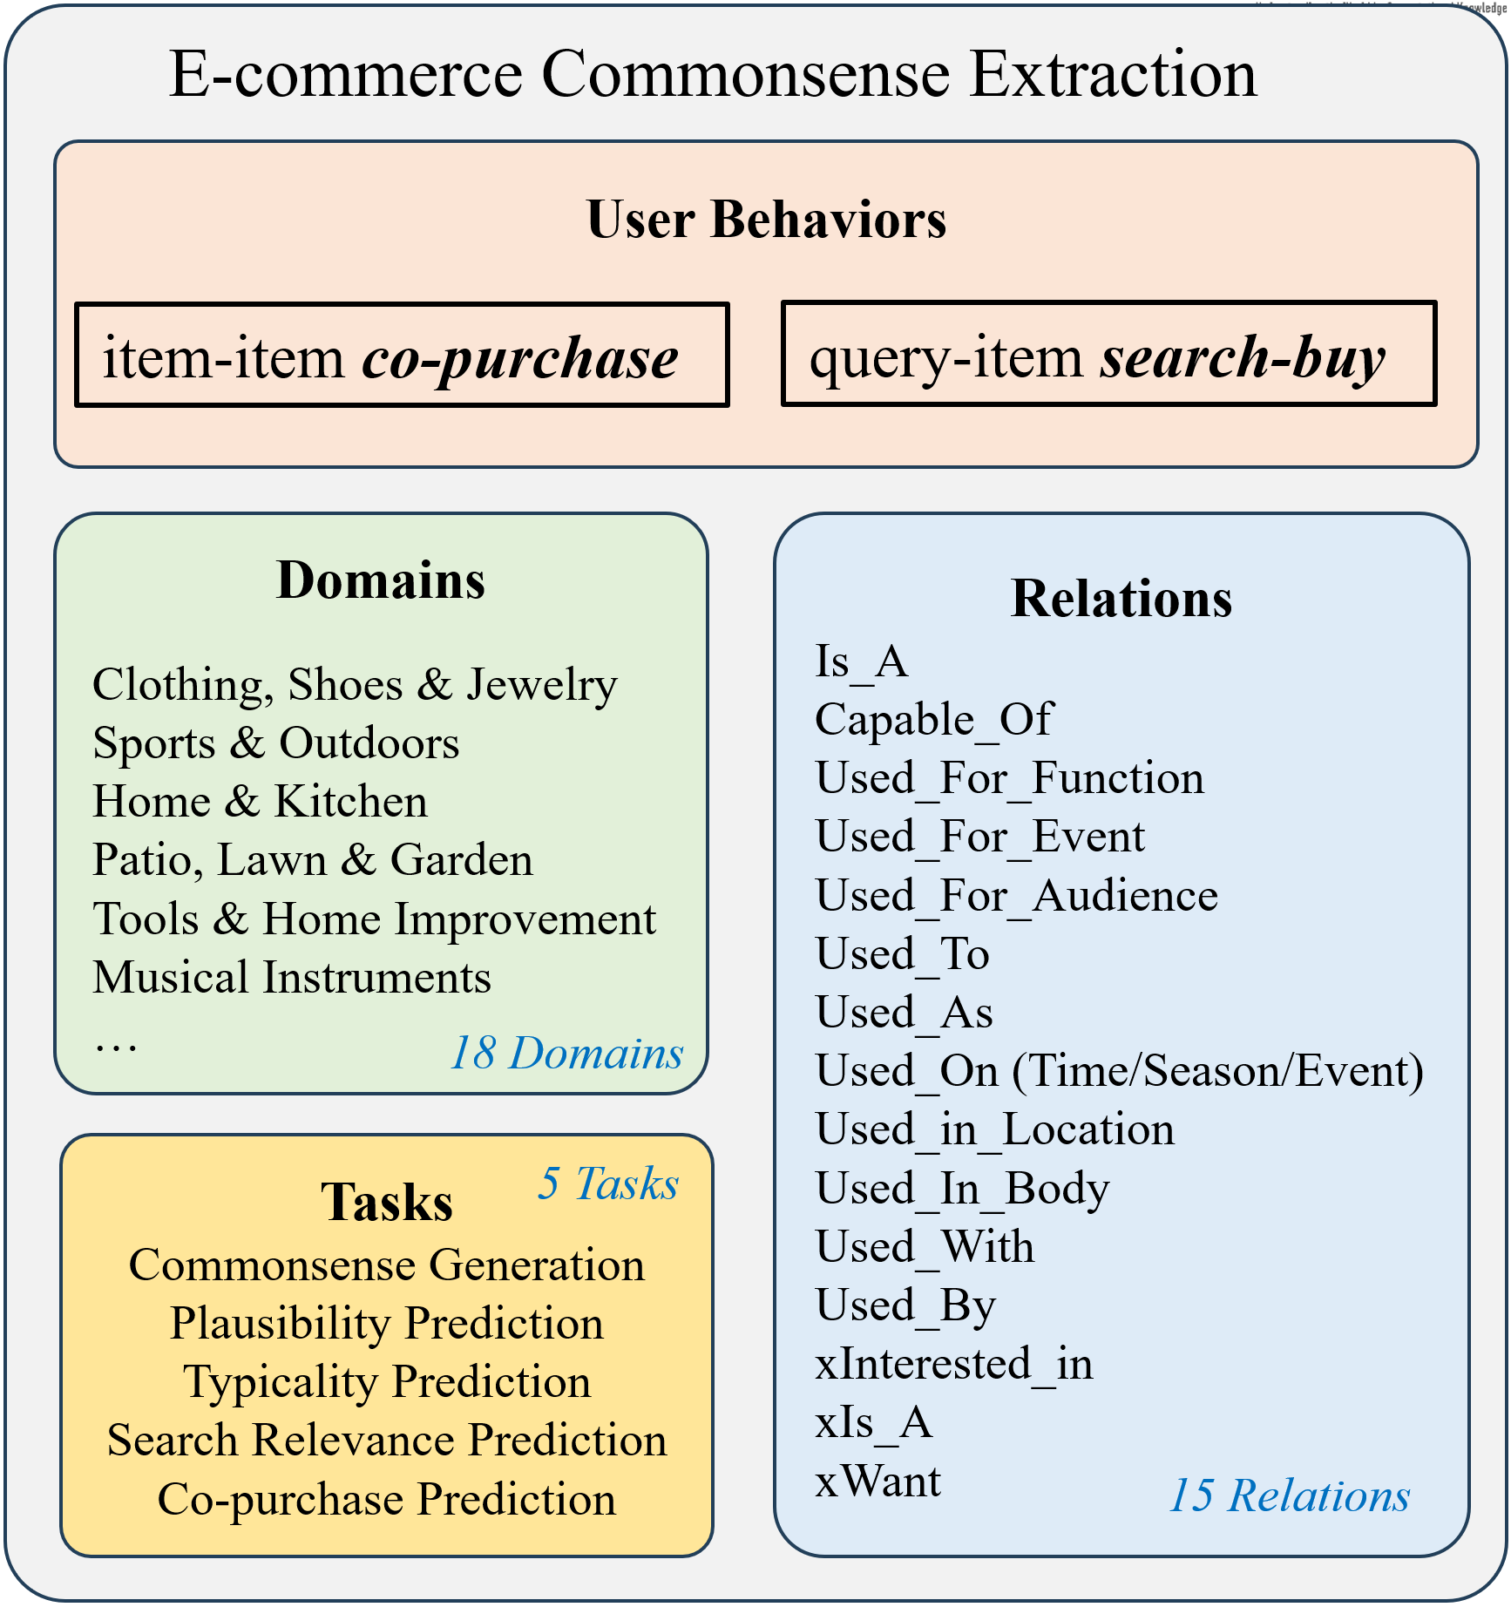
The Three-dimensional Development of Knowledge Graphs in Computer Science
The deveopment of the Web
Web 3.0
Generations of KGs
G#3: Dual Neural KGs
Web 2.0
G#2: Text-Rich KGs
ATOMIC
Generation #2
Web 1.0
Intention and event (cause-effect) knowledge
FolkScope
Generation #2
Web 2.0
Intention knowledge
COSMO
Generation #2
Web 2.0
Intention knowledge
G#1: Entity-Based KGs
Web 1.0
Entities/Concepts/Properties
Events/Processes
Intents/Beliefs/Desires
Semantic Units
Maarten Sap, Ronan LeBras, Emily Allaway, Chandra Bhagavatula, Nicholas Lourie, Hannah Rashkin, Brendan Roof, Noah A. Smith, Yejin Choi: ATOMIC: An Atlas of Machine Commonsense for If-Then Reasoning. AAAI, 2019.
Changlong Yu, Weiqi Wang, Xin Liu, Jiaxin Bai, Yangqiu Song, Zheng Li, Yifan Gao, Tianyu Cao, and Bing Yin. FolkScope: Intention Knowledge Graph Construction for E-commerce Commonsense Discovery. Findings of ACL. 2023.
COSMO: A large-scale e-commerce common sense knowledge generation and serving system at Amazon. By Changlong Yu, Xin Liu, Jefferson Maia, Tianyu Cao, Laurence (Yang) Li, Yifan Gao, Yangqiu Song, Rahul Goutam, Haiyang Zhang, Bing Yin, Zheng Li. SIGMOD Industrial Track. 2024.

Slide 10
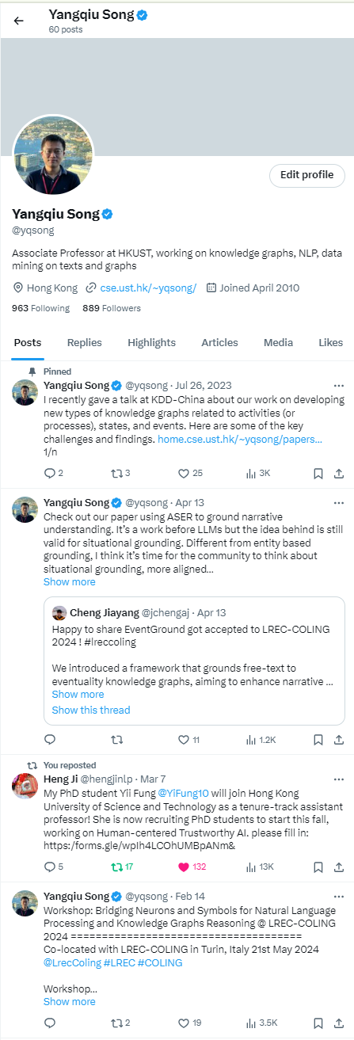
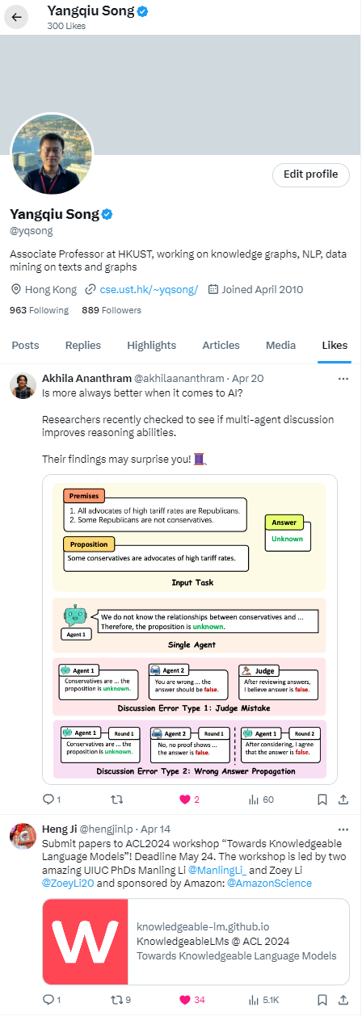
Why do we want to go beyond entities in Web2.0?
User centric and user generated content (UGC)
Explicit incentives :
e.g., user reviews, posting blogs, tweets, photos, videos, etc.
Implicit incentives :
user behaviors, e.g., following, browsing, clicking, searching, upvoting, etc.
Why do I like this post? I like the content or promote my own work?
Why do I post this tweet?
Sell my own work, or promote my student?

Slide 11
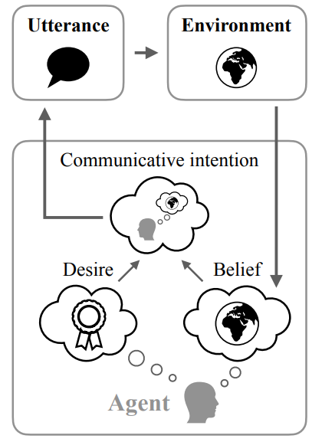
Why do we want to go beyond entities in Web2.0?
“I post this tweet: Sell my own work or promote my student?” Inference involves:
1. Theory of Mind
i.e., the development of knowledge that others have beliefs, desires, and intentions that are different from one's own
Possessing a functional theory of mind is crucial for success in everyday human social interactions
What makes us take actions?
Beliefs and desires are mediated by intentions which in turn controls human’s actions (or speech) (Kashima et al., 1998)
Intentions are implicit
Figure taken from Andreas (2022)
https://en.wikipedia.org/wiki/Intention
https://en.wikipedia.org/wiki/Theory_of_mind
Jacob Andreas: Language Models as Agent Models. EMNLP (Findings) 2022: 5769-5779
Kashima, Yoshihisa, Allison McKintyre, and Paul Clifford. "The Category of the Mind: Folk Psychology of Belief, Desire, and Intention." Asian Journal Of Social Psychology 1, no. 3 (December 1998): 289–313.

Slide 12
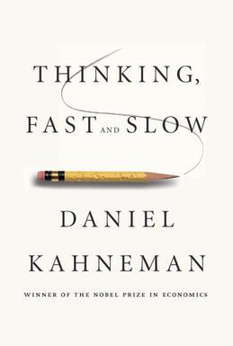
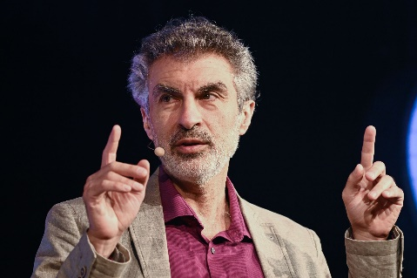
Why do we want to go beyond entities in Web2.0?
“I post this tweet: My student gets more visible or not?” Inference involves:
2. System II Processing
We need to equip machine learning systems with “slow, logical, sequential, conscious, linguistic, algorithmic, planning, reasoning”
Particularly, such a system requires the “understanding of how actions interact with changes (of states) in distribution”
“Agents face non-stationarities”
Conditioned on “different places, times, sensors, actuators, goals, policies, etc”
http://www.iro.umontreal.ca/~bengioy/AAAI-9feb2020.pdf

Slide 13
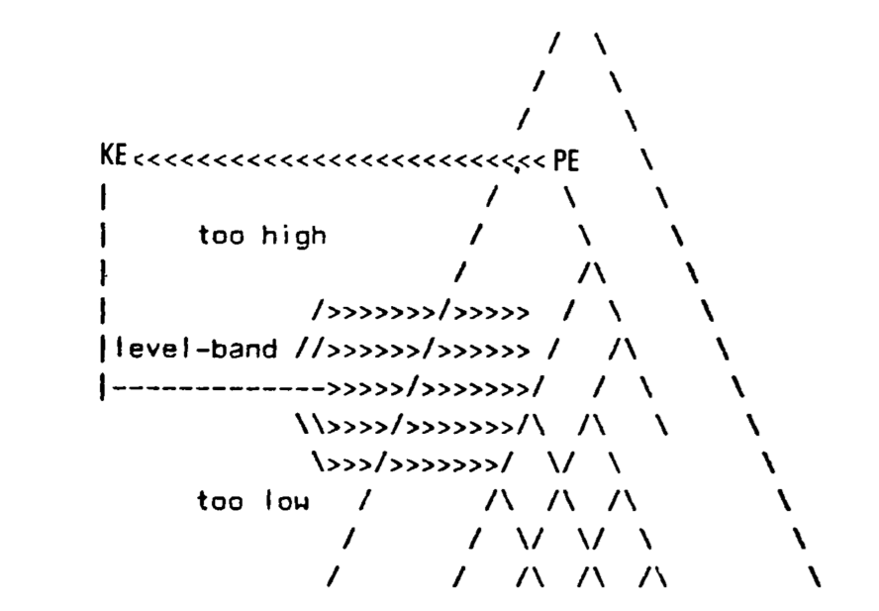
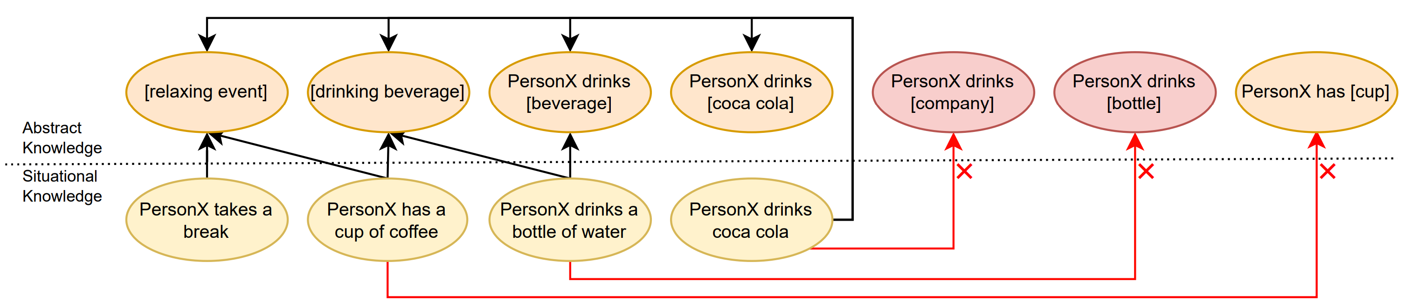
Why Graphs?
The K-Line Theory (Minsky, 1980)
More than ontology: categories include substances, properties, relations, states of affairs, and events
Mental states in our memory are also in a hierarchical structure beyond an ontology; described as a K-pyramid
We need the right level and right perspective of abstraction
Different levels of abstractness: “PersonX drinks coca cola” → “[drinking beverage],” “[event]”
Different perspectives: “Coca cola” → “[sugary beverage],” “[phosphate containing beverage],” “[iced drink],” not in a strict taxonomy
PersonX drinks [iced drink], xReact, refreshed
PersonX drinks [sugary beverage], xEffect, gain weight
K-Pyramid: Minsky (1980)
M. Minsky, “K-Lines: A theory of Memory," Cognitive Science 4 (1980). 117-133.
Mutian He, Tianqing Fang, Weiqi Wang, and Yangqiu Song. Acquiring and Modelling Abstract Commonsense Knowledge via Conceptualization. Arxiv 2022.

Slide 14
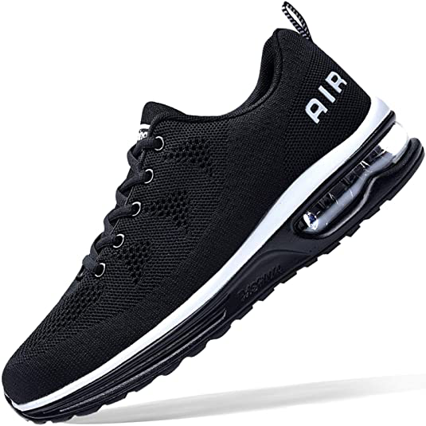


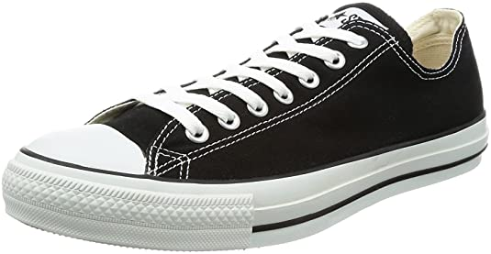
Why Graphs?
Sometimes we need concrete, symbolic, and globally referenced knowledge (Edge et al., 2024)
Ability of commonsense reasoning with high complexity
NP-complete problems, e.g., Max-Sat (Chalier et al., 2022) , subgraph matching or counting, subset sum, etc.
The trade-offs between scalability and computational complexity
Intentions can be pre-stored and indexed to be more efficiently accessed online
Running
Shoes
Complementary
Typical: 👍
Require
Typical: 👍
Event:
Running
Typical: 👍
Require
Weighted Vest
Typical: 👍
Typical: 👎
Typical: 👎
BeCapableOf
Require
Complementary
Person:
Athletes
Typical: 👎
Require
Shoes
From Local to Global: A Graph RAG Approach to Query-Focused Summarization. Darren Edge, Ha Trinh, Newman Cheng, Joshua Bradley, Alex Chao, Apurva Mody, Steven Truitt, Jonathan Larson April 2024
Joint Reasoning for Multi-Faceted Commonsense Knowledge. Yohan Chalier, Simon Razniewski, Gerhard Weikum. ACBC. 2022.

Slide 15


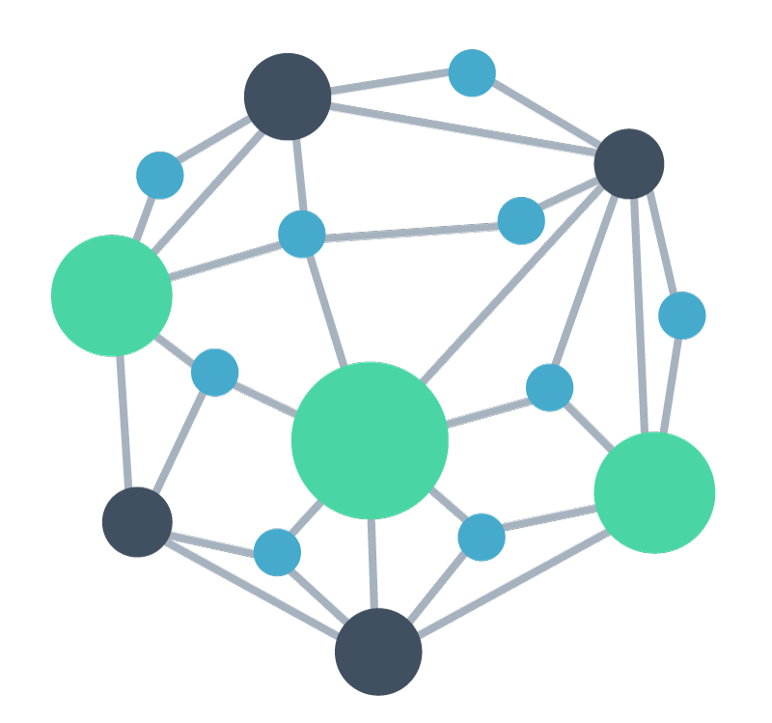

FolkScope and COSMO: User-centric Intention KGs
AI generated knowledge graph construction framework
Actions on E-commerce Platform
Human
Feedback
AIG-KG
Explainable recommendation
AI Generator
UserU bought [A] because
Query-item relevance
PersonX searches [Q] to
User behavior rationalization
Intention KG
PersonX bought [A] and [B] because
PersonX searched [A] and bought [B] because
Pattern mining, Filtering, Normalization, Conceptualization
Prompts
Changlong Yu, Weiqi Wang, Xin Liu, Jiaxin Bai, Yangqiu Song, Zheng Li, Yifan Gao, Tianyu Cao, and Bing Yin. FolkScope: Intention Knowledge Graph Construction for E-commerce Commonsense Discovery. Findings of ACL. 2023.
Changlong Yu, Xin Liu, Jefferson Maia, Tianyu Cao, Laurence (Yang) Li, Yifan Gao, Yangqiu Song, Rahul Goutam, Haiyang Zhang, Bing Yin, Zheng Li. COSMO: A large-scale e-commerce common sense knowledge generation and serving system at Amazon. SIGMOD Industrial Track. 2024.
Hongming Zhang*, Xin Liu*, Haojie Pan*, Haowen Ke, Jiefu Ou, Tianqing Fang, and Yangqiu Song. ASER: Towards Large-scale Commonsense Knowledge Acquisition via Higher-order Selectional Preference over Eventualities. Artificial Intelligence, Volume 309, August 2022, 103740.

Slide 16
FolkScope: Collective Intention KG for Co-Purchases

Slide 17
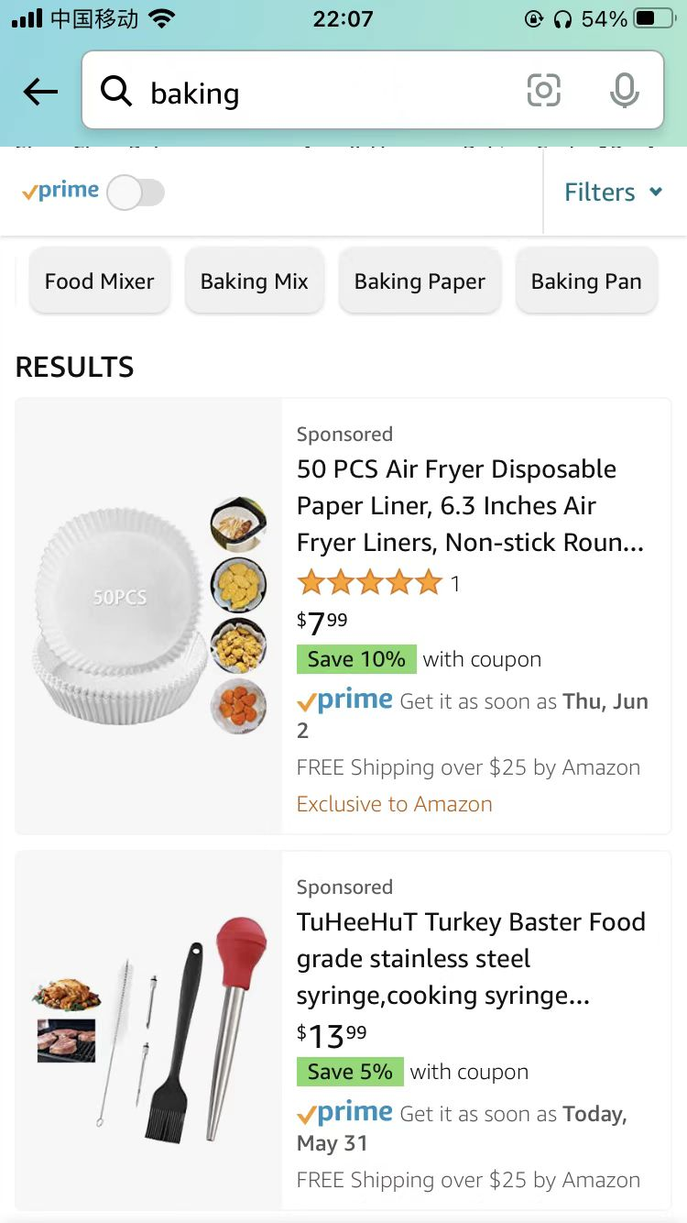
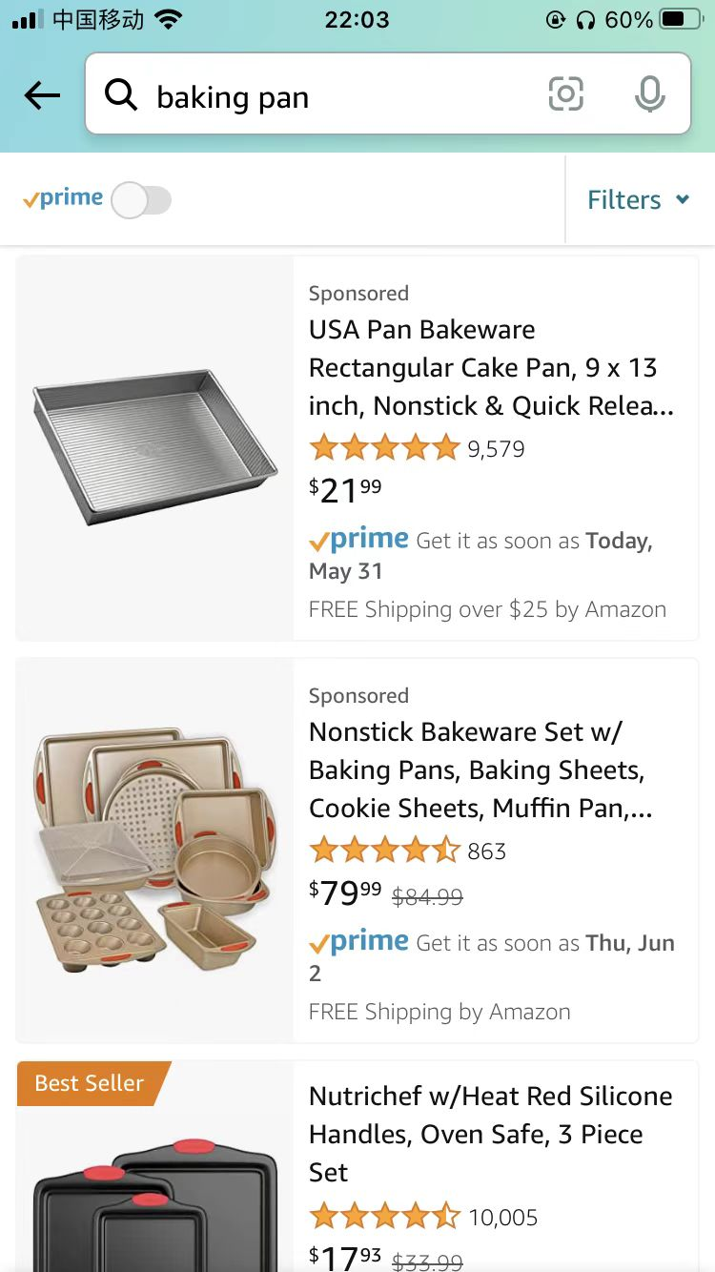

Deployments: COSMO, Intention KG for Search-buy
Efficient feature store and asynchronous cache store
Effectively meets Amazon’s restricted search latency requirements while maintaining storage costs comparable to real-time serving for the majority of traffic
Search query
Search Query Navigation
A/B tests carried out over several months in total
approximately 10% of Amazon’s U.S. traffic
a notable 0.7% relative increase in product sales
translating to hundreds of millions of dollars in annual revenue surge.
Item
Concept
Baking tools
Click
COSMO: A large-scale e-commerce common sense knowledge generation and serving system at Amazon. By Changlong Yu, Xin Liu, Jefferson Maia, Tianyu Cao, Laurence (Yang) Li, Yifan Gao, Yangqiu Song, Rahul Goutam, Haiyang Zhang, Bing Yin, Zheng Li. SIGMOD Industrial Track. 2024.

Slide 18
The Three-dimensional Development of Knowledge Graphs in Computer Science
The deveopment of the Web
Web 3.0
Generations of KGs
What would be the knowledge bases/graphs in Web 3.0?
G#3: Dual Neural KGs
Web 2.0
G#2: Text-Rich KGs
G#1: Entity-Based KGs
Web 1.0
Entities/Concepts/Properties
Events/Processes
Intents/Beliefs/Desires
Semantic Units

Slide 19
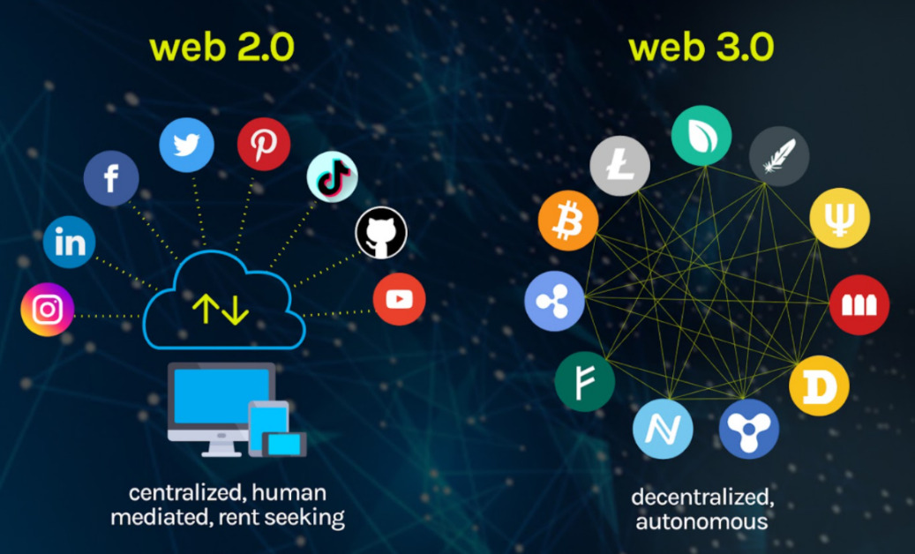
An Outlook
From Web2.0 to Web3.0
Decentralized data: users own their (neural) knowledge bases/graphs
Monetarize by users’ data and time
Permissionless, trustless, but accessible to users’ owned knowledge or data
Security and privacy of data and knowledge is the key!
Figure from: https://vitalflux.com/what-is-web3-0-features-design-skills-nfts/

Slide 20
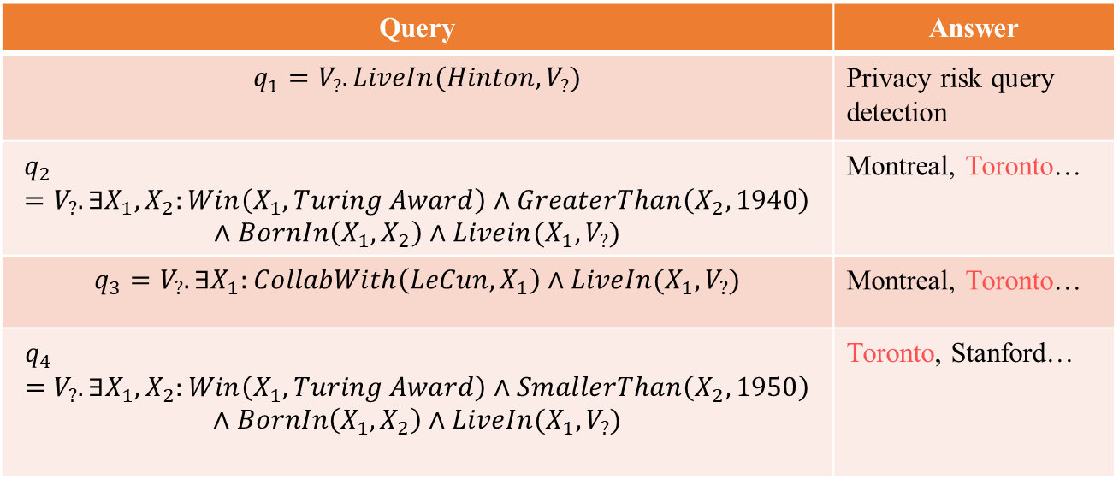
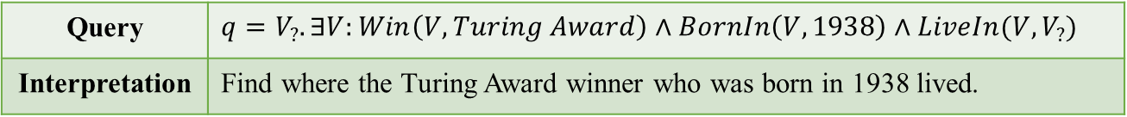
Privacy-preserved NGDBs
An attacker attempts to infer private information about Hinton’s living place in the NGDBs. Attackers can leverage well-designed queries to retrieve desired privacy. The intersection of these queries can make a fair guess.
Toronto
Query | $q=V_{?}. ∃V:Win\left(V, Turing Award\right)∧BornIn\left(V, 1938\right)∧LiveIn(V, V_{?})$
Interpretation | Find where the Turing Award winner who was born in 1938 lived.
UofT
Stanford
Turing Award
Complex Queries
Hinton
1938
Query | Answer
$$q_{1}=V_{?}. LiveIn(Hinton, V_{?})$$ | Privacy risk query detection
$$q_{2} =V_{?}. ∃X_{1}, X_{2}:Win\left(X_{1}, Turing Award\right)∧GreaterThan\left(X_{2},1940\right)$$ $$∧BornIn\left(X_{1},X_{2}\right)∧Livein(X_{1},V_{?})$$ | Montreal, Toronto…
$$q_{3}=V_{?}. ∃X_{1}:CollabWith\left(LeCun, X_{1}\right)∧LiveIn(X_{1},V_{?})$$ | Montreal, Toronto…
$$q_{4}=V_{?}.∃X_{1},X_{2}:Win\left(X_{1}, Turing Award\right)∧SmallerThan\left(X_{2},1950\right)$$ $$∧BornIn\left(X_{1},X_{2}\right)∧LiveIn(X_{1},V_{?})$$ | Toronto, Stanford…
1947
Knuth
Bengio
LeCun
New York
1964
Montreal
Public edge
Private edge
Neural Graph Databases
Qi Hu, Haoran Li, Jiaxin Bai, Zihao Wang, Yangqiu Song. Privacy-Preserved Neural Graph Databases. Arxiv, 2024.
Privacy Risk Queries

Slide 21

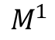
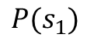
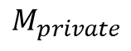
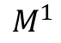
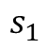
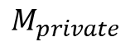
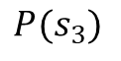
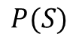
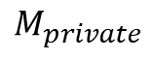
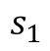
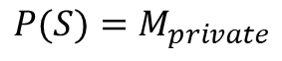
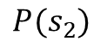
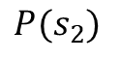
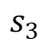
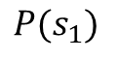
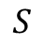
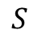
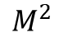
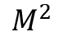
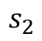

Privacy-preserved NGDBs: Adversarial Training Examples
$$P(s_{1})$$
$$M_{private}$$
$$s_{1}$$
projection
$$M^{1}$$
$$M^{1}$$
$$s_{2}$$
$$M_{private}$$
$$P(s_{3})$$
$$M_{private}$$
$$S$$
$$s_{3}$$
$$P(s_{2})$$
$$P(S)$$
$$s_{1}$$
projection
$$P(s_{1})$$
$$s_{2}$$
$$P(s_{2})$$
$$M^{2}$$
$$M^{2}$$
$$S$$
$$P(S){=M}_{private}$$
(A) Projection
(B) Intersection
(C) Union
Green nodes denote non-private answers, orange nodes denote privacy-threatening answers, and orange-green nodes denote different privacy risks in subsets. Red dashed arrows denote privacy projection. The answers circled in red dashed line are at risk to leak privacy.

Slide 22
Conclusions for Part 4-1
We have reviewed the frontier of recent development of knowledge graphs in terms of three dimensions
Three generations: entity, text, and neural
Semantic units: entity/attributes, events/processes, intent/desire/belief
Web 1.0/2.0/3.0
More methods will be introduced in Part 4-2 by Jiaxin Bai
In terms of different types of semantic units

